Slide 1

15-Minute City Explorer
Explore a transformative urban planning approach that empowers residents to access their daily needs within a 15-minute walk or bike ride.

Slide 2
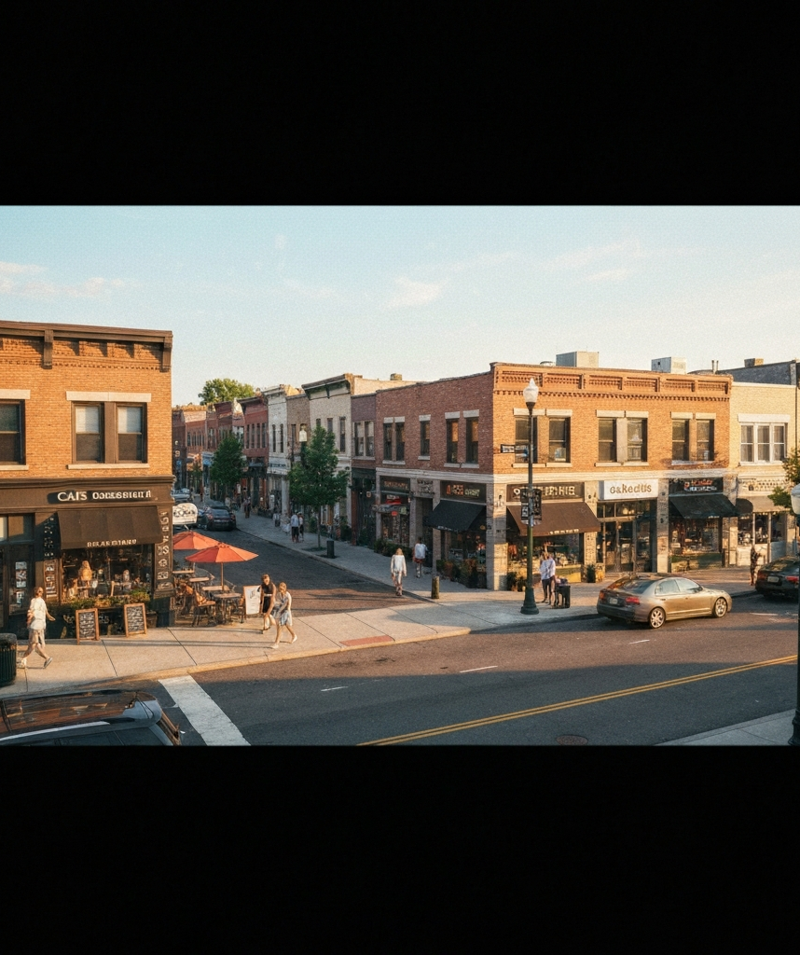
What Is a 15-Minute City?
The 15-Minute City is a transformative urban planning concept that envisions a human-scale, mixed-use neighborhood where most daily needs can be accessed within a 15-minute walk or bike ride. It is based on the principles of proximity, diversity, and accessibility, aimed at empowering residents to live, work, and thrive in their local communities without relying solely on private vehicles.

Slide 3
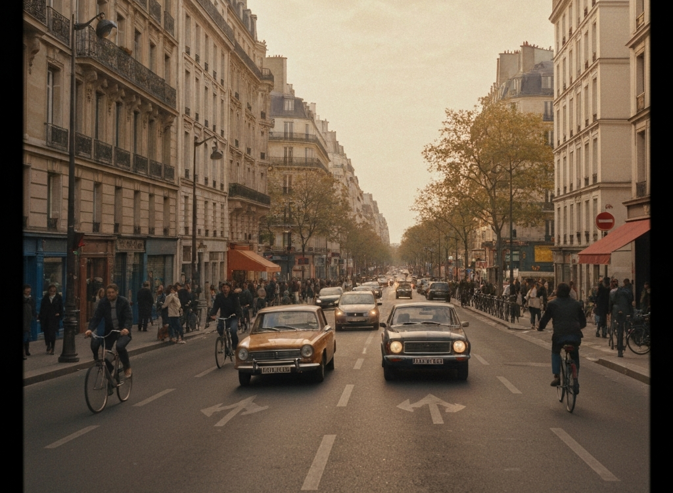
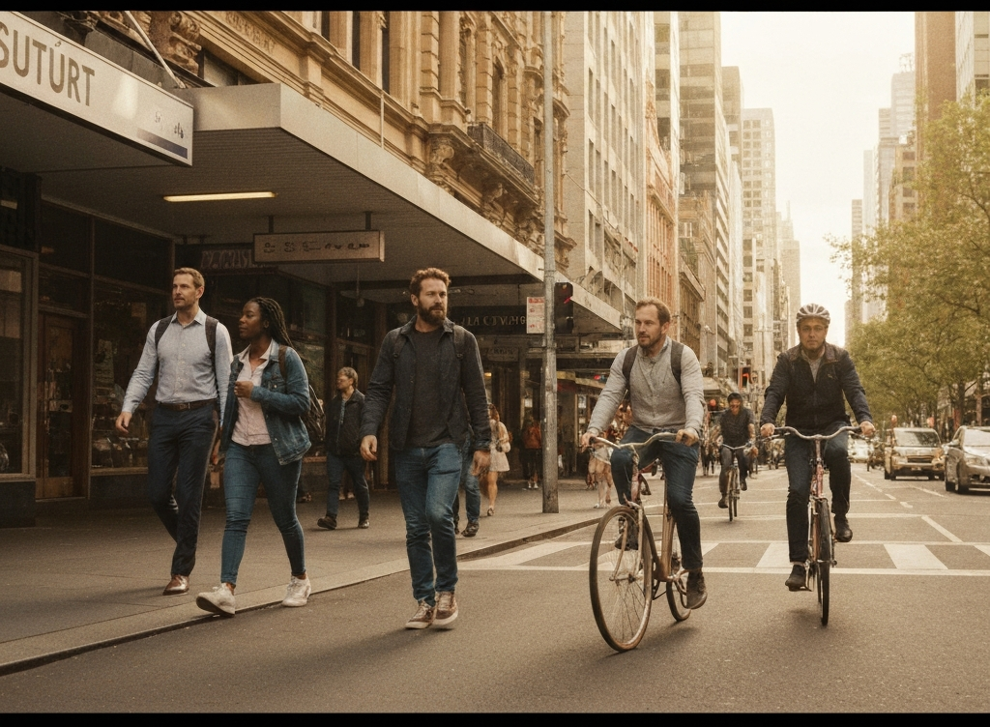
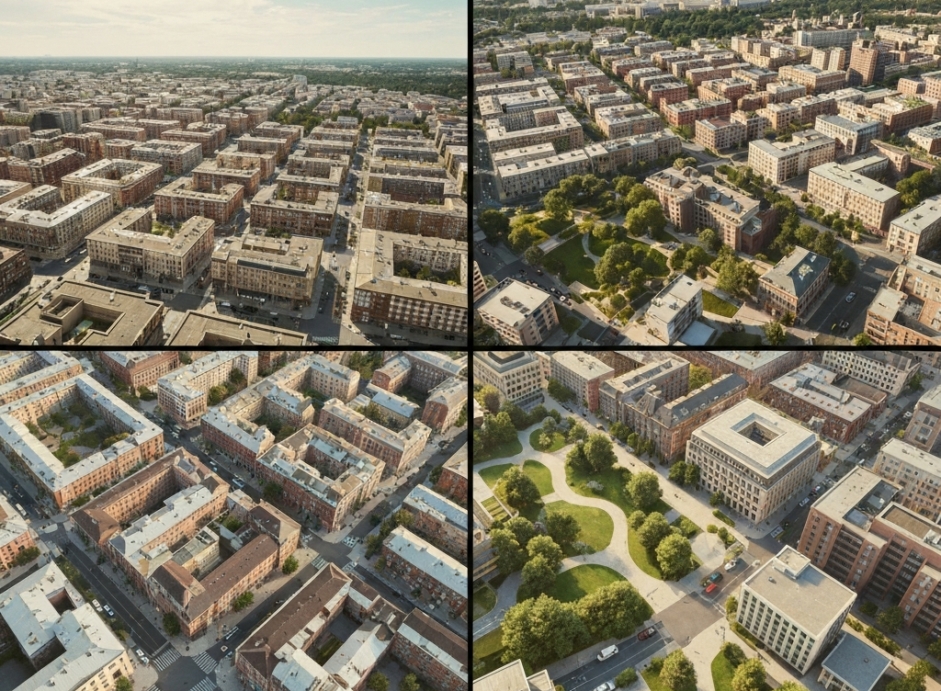
Case Studies: Paris & Melbourne
Paris 15-Minute City Initiatives
Melbourne's 20-Minute Neighborhoods
Comparing Approaches
'Rues aux écoles' (car-lite school streets), neighborhood-scale amenities and micro-hubs, protected cycleways connecting arrondissements
Pair quick-build trials with permanent upgrades; communicate benefits at the block level. Use activity center hierarchy to stage investment; align with health outcomes.
Activity centers as anchors, green links/laneways network, health and aging-in-place focus

Slide 4
Street Redesign Elements
Continuous Sidewalks
Protected Bike Lanes
Bus Priority
Provide curb ramps and tactile paving to ensure accessibility and safety for all users.
Implement physically separated bike lanes with intersection protection to create a safe and inviting cycling network.
Dedicate lanes and queue jumps to improve transit reliability and speed, while enabling all-door boarding.
Traffic Calming
Curb Management
Green Infrastructure
Reduce design speeds to 30 km/h with raised crossings, chicanes, and other measures to create a pedestrian-friendly environment.
Allocate space for loading zones, micromobility parking, and parklets to balance access and activate the public realm.
Incorporate shade trees, bioswales, and permeable surfaces to enhance the urban canopy, manage stormwater, and reduce urban heat.

Slide 5
Mixed-Use Zoning Toolkit
Relative impact on key 15-Minute City outcomes (0-100 scale)
90%
85%
75%
80%
70%
Walkability
Housing Supply
Local Services
Affordability
Small-Biz Vitality

Slide 6







Mobility Modes & Networks
Walking
Cycling
Transit
Private Vehicle

Slide 7
Equity & Accessibility
Invest first in underserved neighborhoods (access deserts)
Prioritize infrastructure and services in areas with the least access to daily needs, as identified through detailed mapping and data analysis.
Zero-fare/transit discounts for low-income riders and youth
Ensure affordability of public transportation to enable access for all residents, especially those with the greatest financial constraints.
Anti-displacement: community land trusts, right-to-return, rent stabilization
Implement a suite of anti-displacement measures to prevent the loss of affordable housing and maintain diversity as neighborhoods are improved.
Safe routes to school and late-night worker corridors
Design mobility networks that cater to the needs of vulnerable users, such as children and late-shift employees, with a focus on safety and accessibility.
Community co-design: multilingual workshops, stipends, childcare
Engage residents, especially those from underrepresented groups, in the planning and design process through inclusive, accessible, and well-facilitated workshops and forums.

Slide 8
Misconceptions & Myth-Busting
Myth: 15-minute cities 'restrict movement'
Fact: They expand choices by bringing more nearby; regional and intercity travel remains.
Myth: It's anti-car
Fact: It's pro-option; safer walking/biking/transit plus smarter car use.
Myth: Only works in dense European cores
Fact: Applicable with context—retrofit arterials, re-center town centers, and add mixed uses.
Myth: Hurts business
Fact: Foot traffic and dwell time typically increase on people-first streets.
Myth: Too expensive
Fact: Low-cost pilots and curb pricing fund phased, high-return upgrades.
Myth: One-size-fits-all
Fact: Co-designed with neighborhoods; services reflect local needs.

Slide 9


Costs and Benefits
Item
NPV (USD M per 100k residents)
Quick-build pilots (paint/posts/planters)
12
Permanent streetscape + bikeways
85
Transit priority upgrades
30
Public realm/trees/stormwater
18
Ops/maint. (net of savings)
22
Curb pricing/parking reform
-28
Speeding/crash cost reductions (city savings)
-15
Travel time saved (mode shift/shorter trips)
-190
Health (active mobility; reduced PM2.5)
-120
Crash reduction (ped/bike/veh)
-150
*Illustrative 10-year NPV analysis per USDOT guidance and existing studies on 15-Minute City interventions.

Slide 10




Implementation Roadmap & Metrics
Phasing
Workstreams
Dashboard Specification
Gantt Chart Roadmap
Outlines a three-phase implementation plan with key milestones and actions for the short-term (0-6 months), medium-term (6-18 months), and long-term (18-36 months).
Identifies the core program areas that will guide the implementation, including Streets & Safety, Land Use & Housing, Transit & Operations, Equity & Community, and Data & Evaluation.
Defines the layout and content of a comprehensive performance dashboard to track key metrics across mode share, safety, accessibility, economic vitality, and compliance with the 15-Minute City vision.
Presents a multi-lane Gantt chart that visualizes the phased implementation timeline and key milestones across the different workstreams.

Slide 11
Agenda
Definition & Principles
Defining the 15-Minute City concept and its key guiding principles
Case Studies: Paris & Melbourne
Examining how the 15-Minute City approach has been implemented in different cities
Street Redesign Elements
Outlining the key components of a complete street for a 15-Minute City
Mixed-Use Zoning Toolkit
Showcasing zoning tools that support diverse, human-scale neighborhoods
Mobility Modes & Networks
Exploring the integration of various mobility options for a comprehensive, accessible network
Equity & Accessibility
Highlighting strategies to ensure equitable benefits for all residents
Misconceptions & Myth-Busting
Addressing common misconceptions about the 15-Minute City and providing factual counterpoints
Costs and Benefits
Presenting an illustrative cost-benefit analysis of implementing the 15-Minute City approach
Implementation Roadmap & Metrics
Outlining a phased implementation plan and a dashboard of key performance indicators

Slide 12
15-Minute City: Explainer
The 15-Minute City is a transformative urban planning approach that has the potential to create more livable, sustainable, and equitable communities. By prioritizing proximity, diversity, and accessibility, cities can empower residents to meet their daily needs within a 15-minute walk or bike ride, reducing reliance on private vehicles.

Slide 13
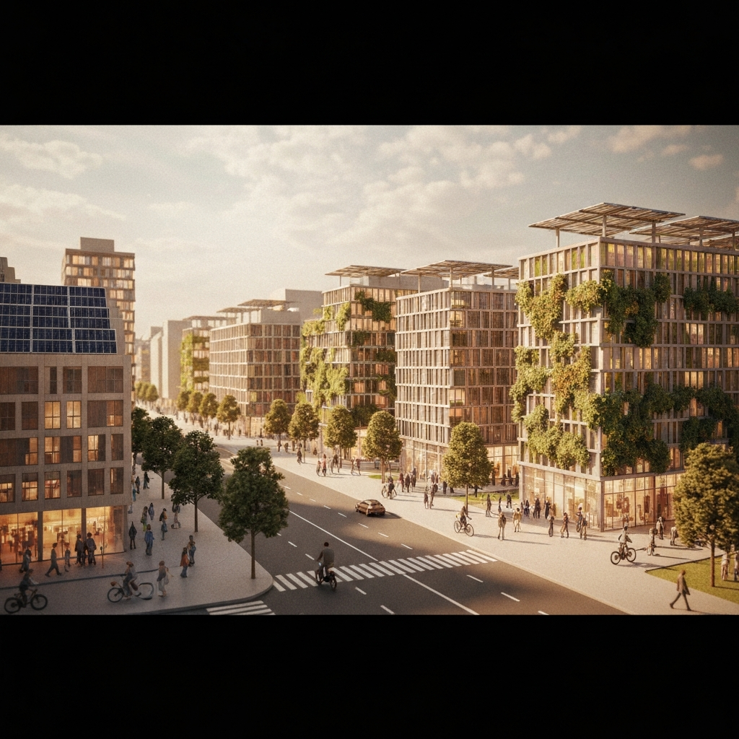
The 15-Minute City offers a holistic vision for creating more livable, equitable, and sustainable communities by prioritizing proximity, diversity, and accessibility. By empowering residents to meet their daily needs within a short walk or bike ride, cities can improve quality of life, foster local economies, and address environmental challenges. As this transformative concept gains global attention, it will be crucial to adapt the strategies to local contexts and ensure inclusive implementation that benefits all residents.

